Slide 1

Project IV
Andrew Middleton
Haseen Ayon
Karen Lin
Sunjae Youm
10/17/2024

Slide 2
Introduction
We were curious about how the personal loan process works in real life, so we decided to explore a loan dataset. We found a dataset on Kaggle that contains customer demographics and loan characteristics. Using this data, we aimed to build a model that can classify whether a customer's future loan status will result in default or no default. In other words, clarifying whether the loan applicant is qualified or not qualified.
Data Source: https://www.kaggle.com/datasets/prakashraushan/loan-dataset

Slide 3

Table of contents
Introduction
Objectives
Data Exploration
i. Demographic
ii. Loan Characteristics
Machine Learning Models
i. Logistic Regression
ii. Random Forest/Tree
iii. Neural Network
Conclusion

Slide 4
Objectives
Primary Objective: Build machine learning models to predict the customer’s future loan status based on the current information
Progress Objectives
Understanding Dataset
Cleaning and optimizing the dataset
Create ML models

Slide 5
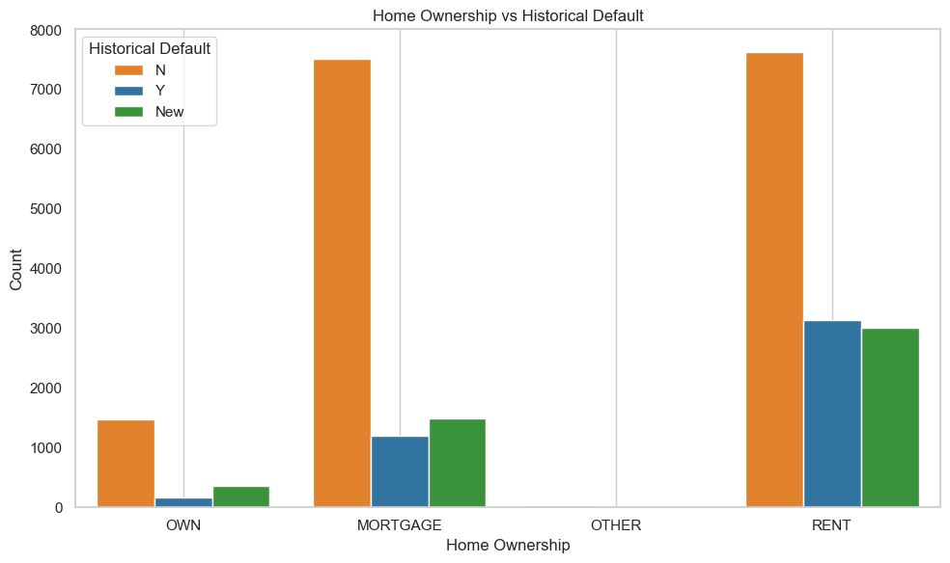
III. Data Exploration (Demographic)
Home Ownership vs Loan Acceptance:
The graph shows that homeowners have lower loan default rates than renters. Homeownership promotes financial stability, as homeowners prioritize mortgage payments, while renters face more volatility, increasing their default risk.

Slide 6
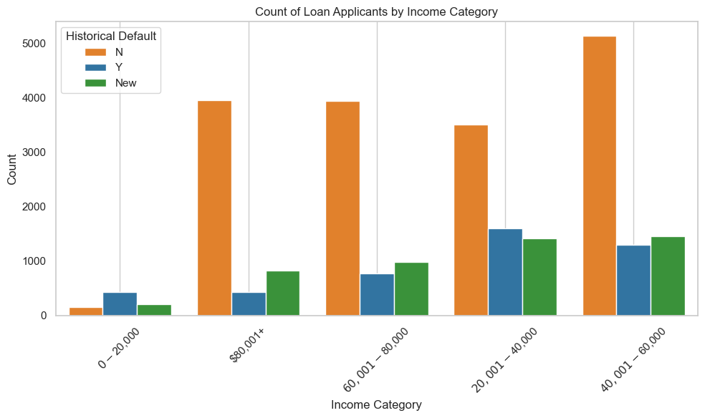
III. Data Exploration (Demographic)
Count of Loan Applicants by Income Category:
The data shows loan applicants by income level, revealing that lower-income individuals have higher default rates, while higher-income applicants are less likely to default. This highlights the link between income and loan repayment behavior.

Slide 7
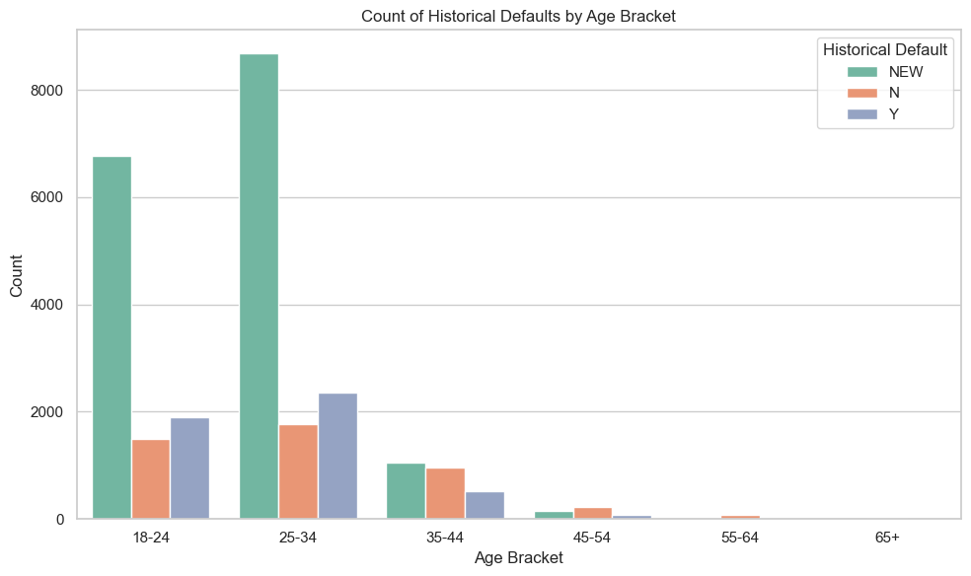
III. Data Exploration (Demographic)
Count of Loan Applicants by Income Category:
The data shows historical defaults by age bracket, revealing that younger borrowers have higher default rates, while older groups tend to default less. This highlights the influence of age on loan repayment behavior.

Slide 8
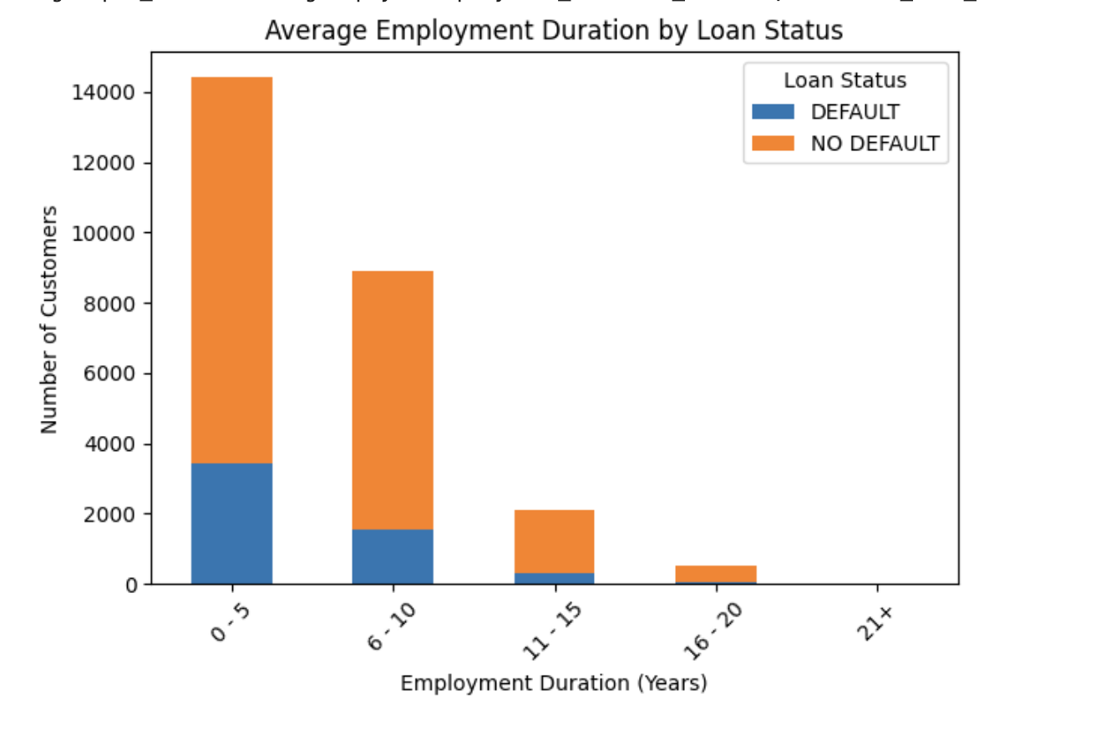
III. Data Exploration (Loan Characteristics)
Most customers fall within the 0–5 years employment duration bucket, where default rates are notably high.
Shorter employment durations may indicate higher financial instability or lower savings among individuals.
Longer employment durations appear to promote financial stability, with fewer defaults observed over time.

Slide 9
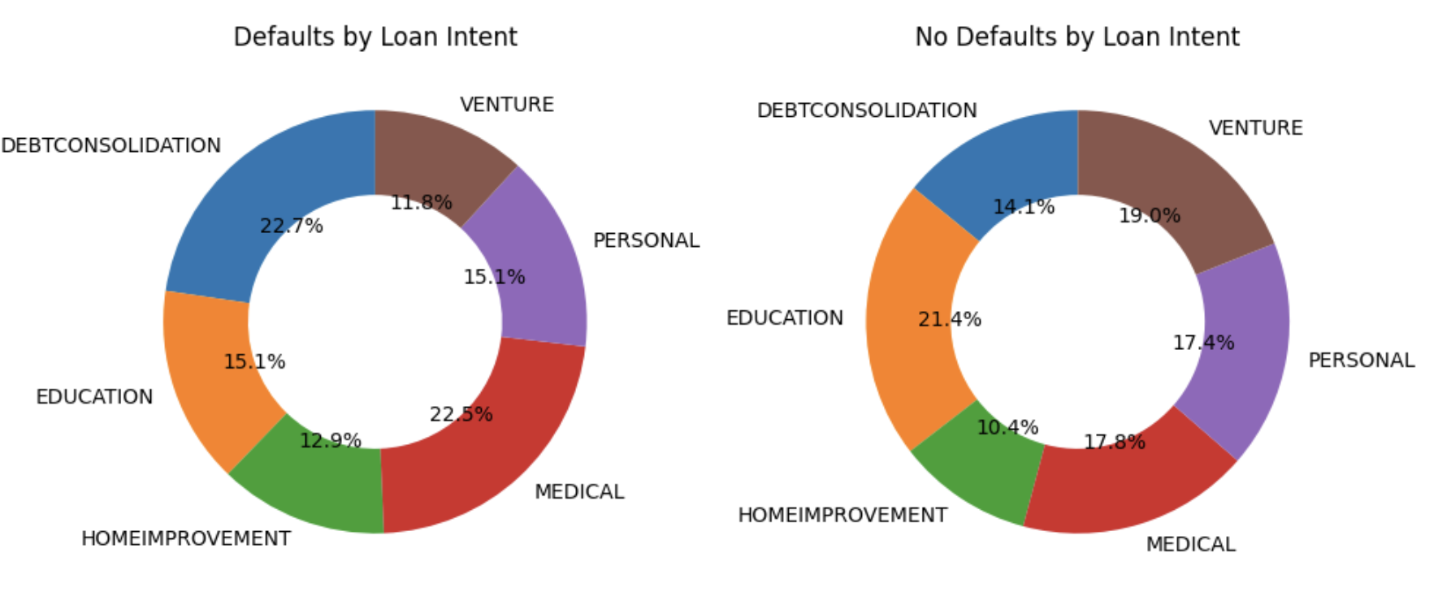
III. Data Exploration (Loan Characteristics)
Lenders may adjust risk models and offer flexible repayment plans or lower interest rates for high-risk borrowers.
High defaults in educational or medical loans may indicate financial stress from education or healthcare costs.
Low default rates, like in home improvement loans, suggest borrowers are more financially stable or have more assets.

Slide 10
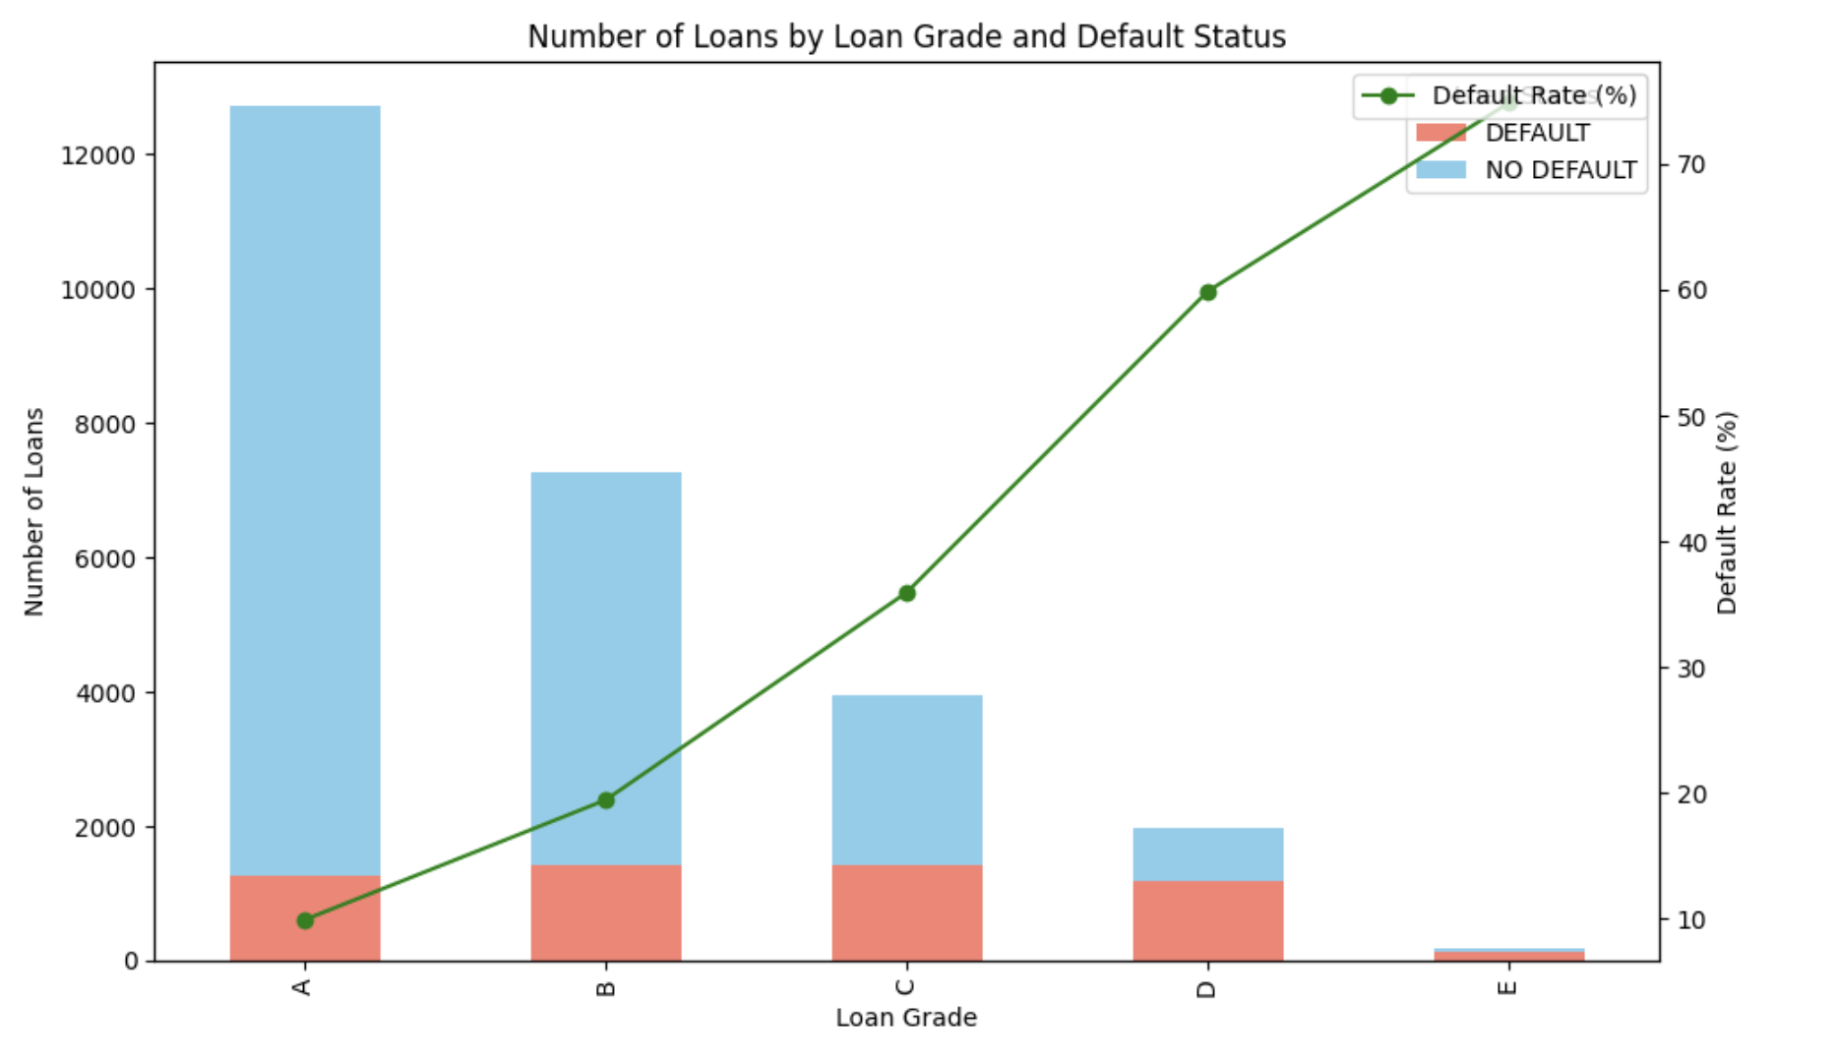
III. Data Exploration (Loan Characteristics)
Loan grades A or B have fewer defaults, showing that higher credit quality leads to better loan management.
Lower grades like C have more defaults, indicating higher risk for lenders.
As loan grades decline, default rates increase, reflecting weaker financial standing and greater lending risks.

Slide 11

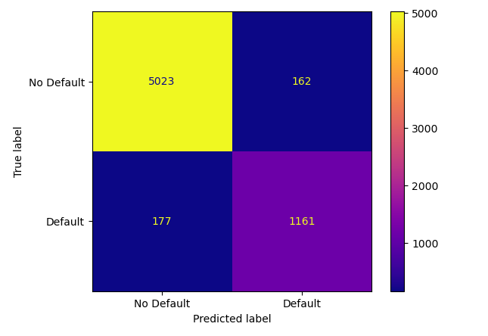
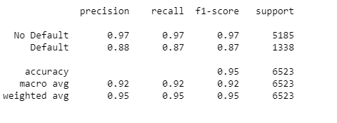
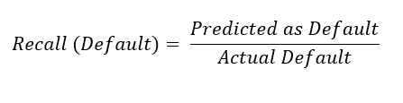
IV. Machine Learning Models (Logistic Regression)
Makes prediction of whether loan will default or not based on its calculated probabilities of defaulting or not
Whichever probability is > 0.5 is the outcome the model predicts
Even though this model has a high accuracy, the recall for default is 87%, meaning there is a 13% financial loss, so this model is not preferable for the lending business

Slide 12
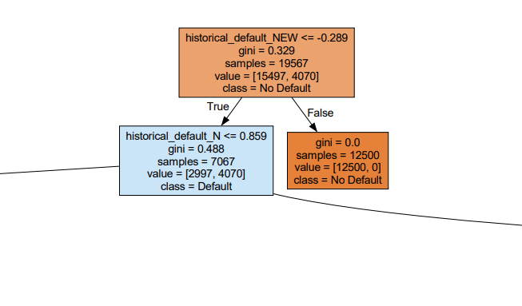
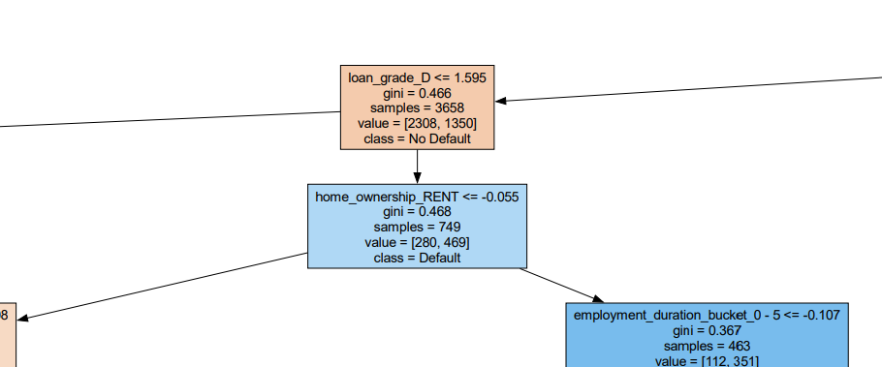
IV. Machine Learning Models (Decision Tree)
Characteristics
Max depth: 10
Top 5 important features:
historical_default_NEW
historical_default_N
age_group_35 - 44
age_group_45 - 54
loan_grade_D
Node Terms
Gini index: measures how well a node contains a single class, reflecting how effective the split is (Open AI, 2024)
Samples: number of data points belonging to the node
Value: [number of data in No Default group, number of data in Default group]

Slide 13
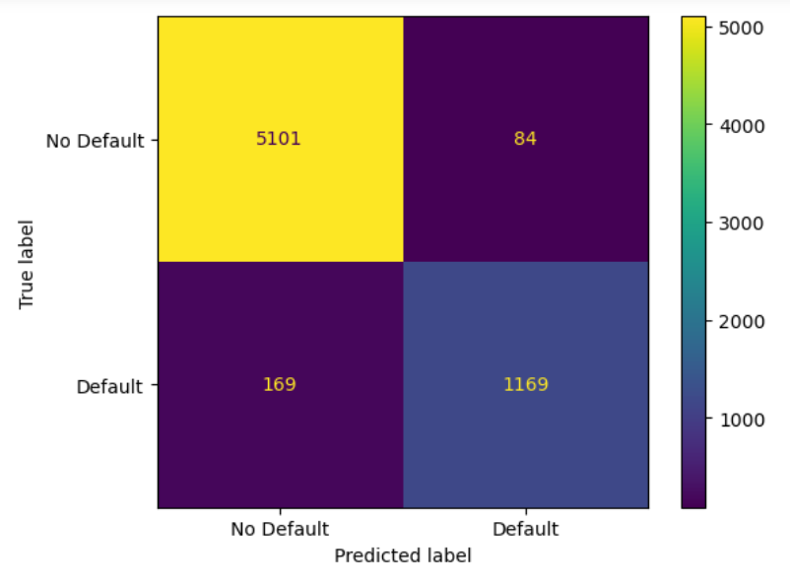
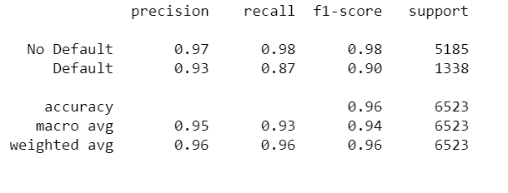
IV. Machine Learning Models (Decision Tree)
Even though this model has a high accuracy of 96%, the recall for default is 87%, meaning there is a 13% financial loss, so this model is not preferable for the lending business

Slide 14
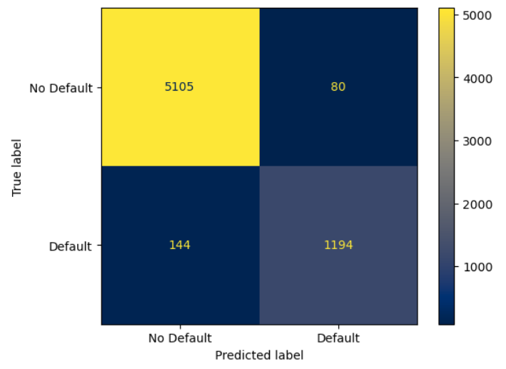
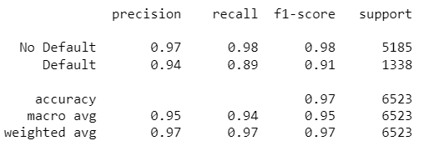
IV. Machine Learning Models (Random Forest)
Created with an ensemble of trees (100)
Predictions based on the majority consensus among the trees
Has a high accuracy of 97% and a recall (default) of 89%, indicating a 11% financial loss for the lending business.
More beneficial to the lending business compared to logistic and tree models because of smaller financial loss
Less useful for informing a consumer of what they can change so that they obtain a model prediction of ‘No Default’, making the lending business more inclined to grant them a loan

Slide 15

IV. Machine Learning Models (Neural Network)
Divide the cleaned dataset into two
Dataset with bucketed nominal data (df_w_buckets)
Dataset with numerical data (df_wo_buckets)
One-Hot Encode categorical variables (nominal values)
Neural networks require numerical input
Numerical values themselves are already meaningful
Preprocessing datasets
Merge the encoded dataset to df_w_buckets & df_wo_buckets
Setup target variable (Current_loan_status) and features.
Split the preprocessed data (75% vs. 25%)
Fit and Scale train/test data

Slide 16
IV. Machine Learning Models (Neural Network)
Model I- III (with df_w_buckets)
Model I:
Deep learning
8, 4 data nodes
50 epochs
ReLu, sigmoid (output)
Model II:
Deep learning
6, 4 data nodes
50 epochs
ReLu, sigmoid (output)
Model III:
Neural Network
8 data nodes
50 epochs
ReLu, sigmoid (output)
Model IV- VI (with df_wo_buckets)
Model IV:
deep learning
8, 4 data nodes
50 epochs
ReLu, sigmoid (output)
Model V:
deep learning
6, 4 data nodes
50 epochs
ReLu, sigmoid (output)
Model VI:
Neural Network
8 data nodes
50 epochs
ReLu, sigmoid (output)

Slide 17
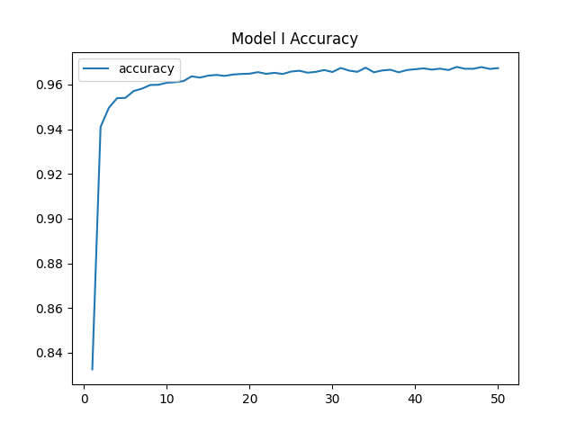
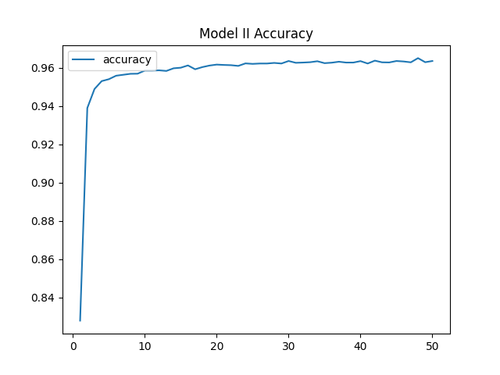
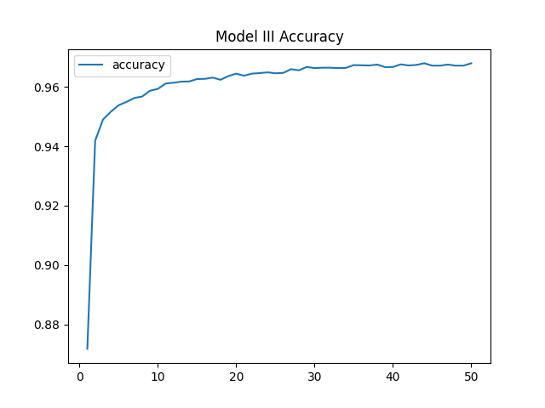
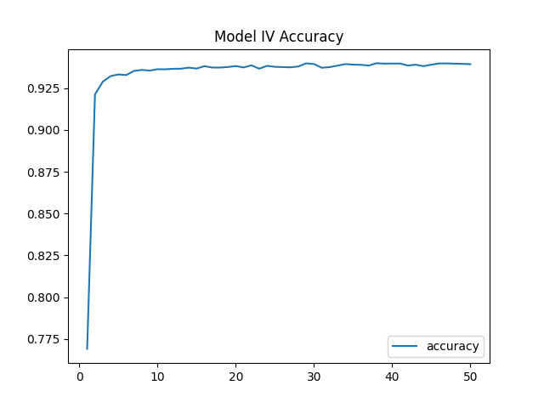
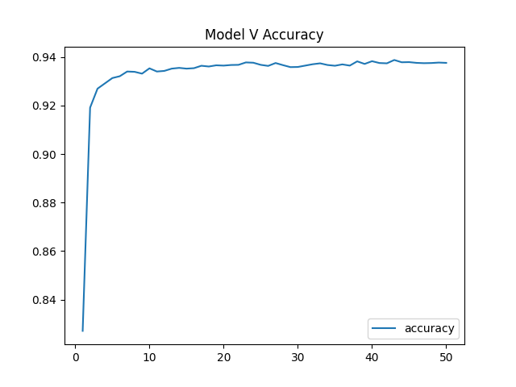
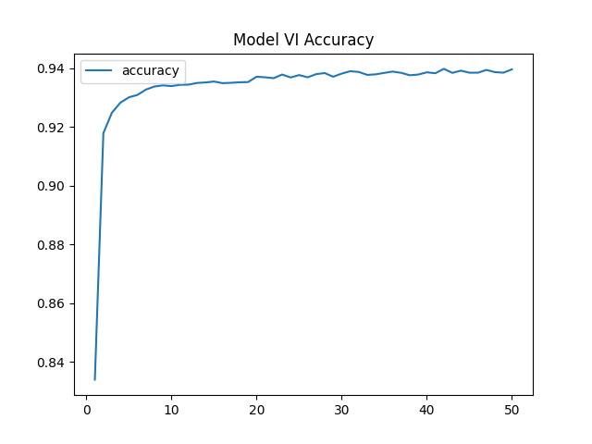
IV. Machine Learning Models (Neural Network)
Loss: 0.106
Accuracy: 0.957
Loss: 0.112
Accuracy: 0.956
Loss: 0.111
Accuracy: 0.962
Loss: 0.149
Accuracy: 0.930
Loss: 0.148
Accuracy: 0.931
Loss: 0.144
Accuracy: 0.932

Slide 18
V. Conclusion
All models achieved over 93% accuracy, with the Random Forest model slightly outperforming others.
MODEL | Accuracy
Logistic Regression | 95%
Decision Tree | 96%
Random Forest | 97%
Neural Network | 93.1%
Deep Learning (DNN) | 95.8%
The results indicate that the models are well-suited for real-world applications, especially in the context of loan status prediction, with the potential to assist in decision-making and risk management in the lending process.

Slide 19
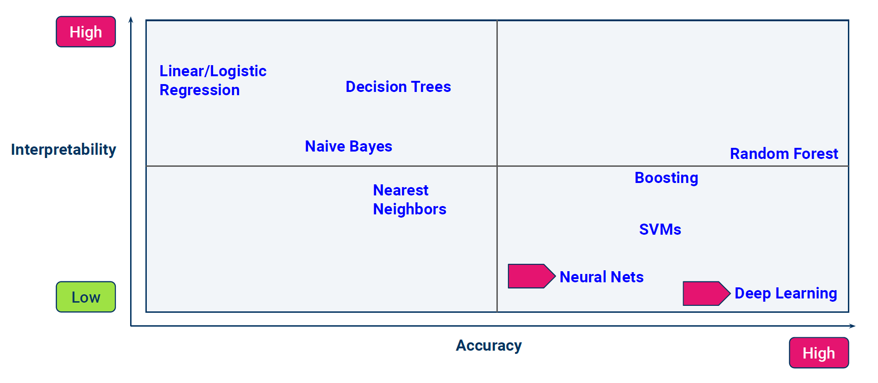
V. Conclusion
95%
96%
Hard to interpret
Interpretable
97%
93.1%
95.8%
Given the need to understand the underlying logic, we recommend using either a Logistic Regression or Decision Tree model. These models also allow us to identify the most influential variables, helping the loan department prioritize key factors when evaluating loan applications.

Slide 20

Questions

